Slide 1

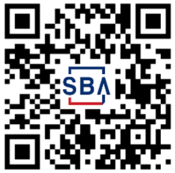
SBA Disaster Loans Available for Businesses and Nonprofits in DeSoto County, Marshall, Tate, & Tunica counties in MS, Crittenden county in AK and Shelby county in TN.
What’s needed to apply
Contact information for all applicants
Applicant cell phone (for verification)
Social security numbers and Employer Identification Numbers (EIN) for all applicants/owners
Financial information (e.g., income, account balances and monthly expenses)
Information about your deed or lease
Insurance information, if available
How to apply
Apply in person - Disaster Loan Outreach Center - DeSoto County
Eudora Volunteer Fire Department - 9341 W. Commerce St., Hernando, MS 38632 Hours: Monday to Friday, 8 a.m. to 6 p.m. Saturday, 10 a.m. to 2 p.m.
Closed: Sunday
Closes Permanently: Thursday, May 11, 4 p.m.
Apply Online at DisasterLoanAssistance.sba.gov
Apply by mail – call (800) 659-2955 to request a paper application
Benefits of an SBA Disaster Loan
Fixed interest rate as low as 4.0% for businesses, 2.375% for nonprofits
12 Months Zero Percent Interest, terms up to 30 years
No collateral up to $14,000
No cost to apply
Funds available to rebuild stronger (Mitigation)
$2 million maximum loan for businesses and nonprofit organizations
Questions? Call (800) 659-2955 (dial 7-1-1 to access telecommunications relay services) or visit sba.gov/disaster
MS 17895
5/2/23

