Slide 1

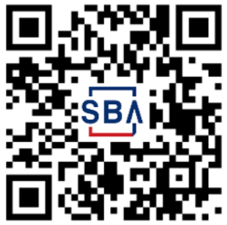
SBA Disaster Loans Available for Homeowners & Renters in DeSoto County, Marshall, Tate, & Tunica counties in MS, Crittenden county in AK and Shelby county in TN.
What’s needed to apply
Contact information for all applicants
Applicant cell phone (for verification)
Social security numbers for all applicants
Financial information (e.g., income, account balances, monthly expenses)
Information about your deed or lease
Insurance information, if available
How to apply
Apply in person - Disaster Loan Outreach Center - DeSoto County
Eudora Volunteer Fire Department - 9341 W. Commerce St., Hernando, MS 38632 Hours: Monday to Friday, 8 a.m. to 6 p.m. Saturday, 10 a.m. to 2 p.m.
Closed: Sunday
Closes Permanently: Thursday, May 11, 4 p.m.
Apply online at DisasterLoanAssistance.sba.gov
Apply by mail – call (800) 659-2955 to request a paper application
Benefits of an SBA Disaster Loan
Fixed interest rate as low as 2.375% for homeowners and renters
12 Months Zero Percent Interest
Terms up to 30 years
No need to wait for insurance to settle to apply for or receive disaster loan
No collateral up to $14,000
Homeowners may borrow up to $200,000 for damage to primary residence
Homeowners / renters may borrow up to $40,000 to replace contents of home
Funds available to rebuild stronger (Mitigation)
Questions? Call (800) 659-2955 (dial 7-1-1 to access telecommunications relay services) or visit sba.gov/disaster
MS 17895
5/2/23

